Slide 1

Expanding Your Networks
How Networks help and hinder your leadership trajectory

Slide 2


Title
1. What is your experience with networking?
2. What is your experience with relationships
that help you be effective at work?

Slide 3
Why Networks?
1. They are important source of influence at work
2. They are how work “really gets done”

Slide 4
Taking a Network Perspective
Exploration & Production
O’Brien
Senior Vice President
Stock
Jones
Exploration
Drilling
Production
Williams
Taylor
Stock
Shapiro
Paine
G & G
Petrophysical
Production
Resevoir
Cohen
Cross
Sen
O’Brien
Shapiro
Smith
Andrews
Moore
Paine
Cohen
Cole
Jones
Hughes
Miller
Kelly
Andrews
Ramirez
Smith
Bell
Hughes
Miller
Williams
Cole
Cross
Hussain
Hussain
Taylor
Kelly
Moore
Ramirez
Bell
Sen
Now, short case study

Slide 5

Leaders With Good Networks
Hear new information early and are able to capitalize on opportunities that require merging of disparate expertise and insights
Are likely to be in an organization’s top 20% of high-performers
Tend to be promoted more rapidly, enjoy greater career mobility, and adapt to changing environments more successfully
Are more influential in corporate structures and organizations that are more complex (boosts performance by 75%)
Let’s find out
Notes:
Outcomes of well constructed networks
I define good networks as … structural diversity, crossing critical boundaries, having quality relationships
What are their key points
They are important
They can be strenghtend
They can be taught
It positively impacts their careers
You can tell if you have a really good network if these things are happening ….
Hear new information early and are able to capitalize on opportunities that require merging of disparate expertise and insights
Are likely to be in an organization’s top 20% of high-performers
Tend to be promoted more rapidly, enjoy greater career mobility, and adapt to changing environments more successfully
Much of Rob’s research supports the research Ron Burt, Professor of Sociology and Strategy at the U of Chicago Booth School of Business, who in the 1990’s conducted a series of research projects on entrepreneurs and found, that entrepreneurs with better networks (more structurally diverse, mix of strong and weak ties) were able to raise more capital (4:1) than those entrepreneurs with not so good at building etworks.
Burt, Ronald S. (1992). Structural Holes. The Social Structure of Competition. Cambridge, Mass.: Harvard University Press.
A famous study done by Ron Burt and Don Ronchi at the U of Chicago, as part of their leadership training, he compared a leadership development program that taught executives the principles of building good networks vs. same level executives that didn’t attend the course. They followed these executives for 2 years to see if training leaders on the science of networking improved the executives performance, what he found was yes it did. In fact program graduates were
26-42% more likely to receive top performance evaluations
43-72% more likely to be promoted
42-74% more likely to be retained by the company

Slide 6

Biases in Your Network
Immediacy
Here and now
Proximity
I see you frequently
Similarity
Birds of a feather flock together
Relational-Inertia
Easier to stay than change

Slide 7
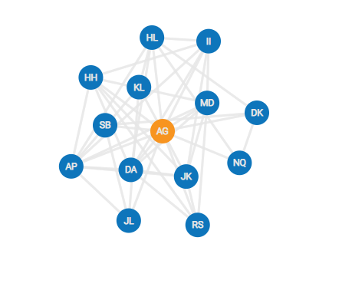
Leader Network Diagnostic

Slide 8
Leader Network Diagnostic
Why did you choose the people you chose?
What are you giving and getting in these relationships?

Slide 9

Key Aspects of Networks
Leaders who have an effective network:
Open
Diverse
Deep
Open
Diverse
Deep

Slide 10

OPEN
Title
The number of people in your core network who don’t know each other.

Slide 11
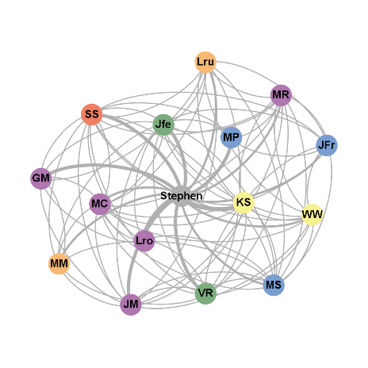
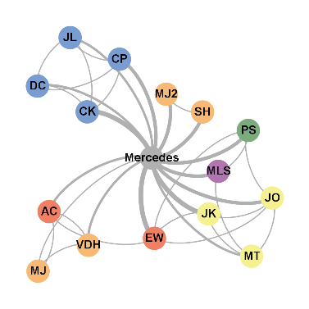
Which network provides more opportunities
CLOSED NETWORK
1
4
3
Joseph
Jane
2
OPEN NETWORK

Slide 12
CLOSED | OPEN
Bonding
Connecting
Increases Groupthink
Increases Group Innovation
Fails to adapt to new situations
Adapts to changing environments
Lack of job/career opportunities
Enjoys greater career mobility
Influence decreases
Influence increases

Slide 13
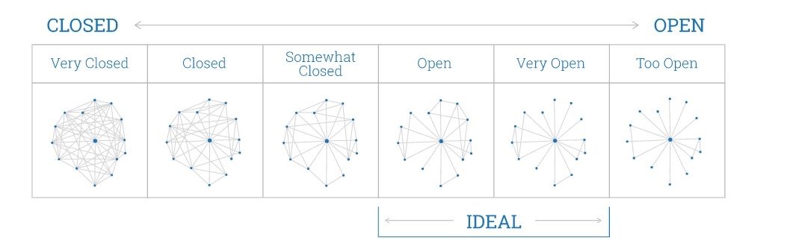

Slide 14

Open/Closed
Let’s find out
Reflection:
Why did you get the score you did?
What are the main factors contributing to how open or closed your network is?

Slide 15

DIVERSE
The boundaries you cross to help achieve your leadership goals.
©2013 Center for Creative Leadership. All Rights Reserved.

Slide 16
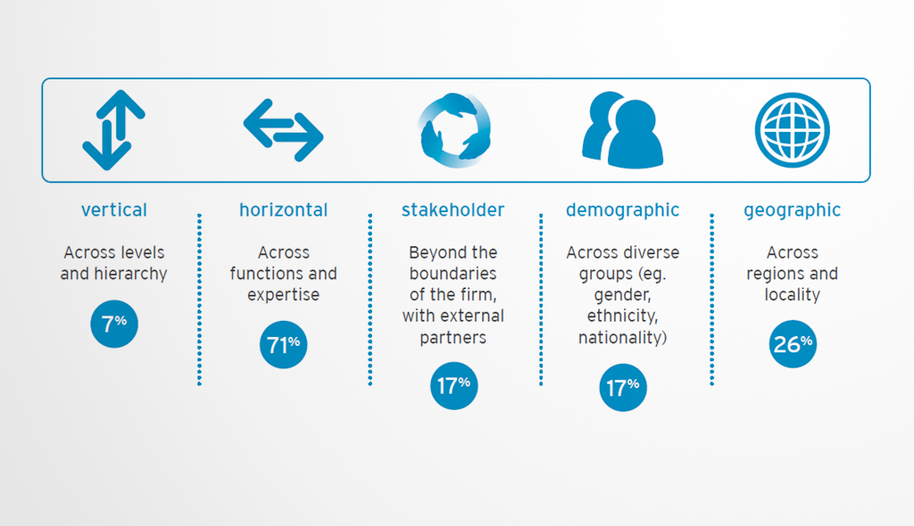
Title
Let’s find out

Slide 17
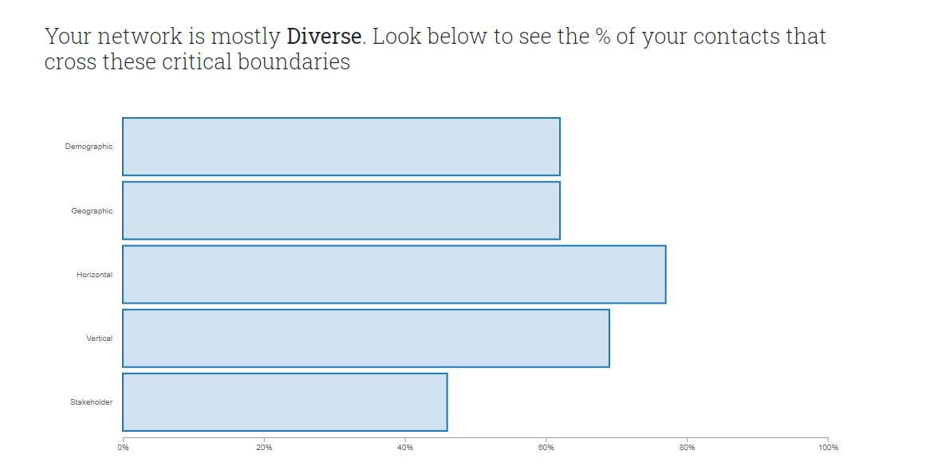
Boundary Spanning

Slide 18

DEEP
Title
The right level of trust to effectively leverage your network when needed.
Let’s find out

Slide 19


One-Way
Directed Benefits
Give OR Take
WEAK TIES
STRONG TIES
Bi-Directional
Mutually Beneficial
Give & Take
RECIPROCITY
Trust is Optional
Loose Commitment
Responsiveness Sometimes
No Disclosure Necessary
Trust
Strong Commitment
Expected Responsiveness
Self-Disclosure
INTIMACY
Ongoing Interaction
Expected
Within last 6 months
Inconsistent/Sporadic
No expectation of contact
Outside of 6 months
FREQUENCY

Slide 20
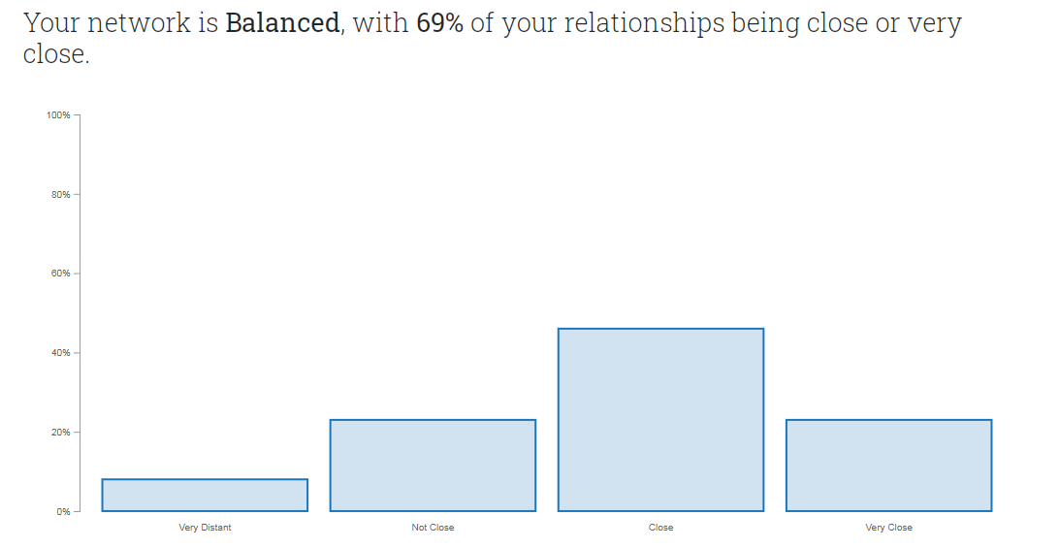

Slide 21

Diagnosing Your Network
Where should I be investing my limited time and energy to make the most effective network?
Notes:
Break!

Slide 22
Your Network enables you to...
Perform in your work by helping you get stuff done and stay engergized.
Progress in your career to achieve your personal aspirations.
Prosper during difficult challenges by providing support and friendship.
Prepare for future opportunities through growth and development.

Slide 23
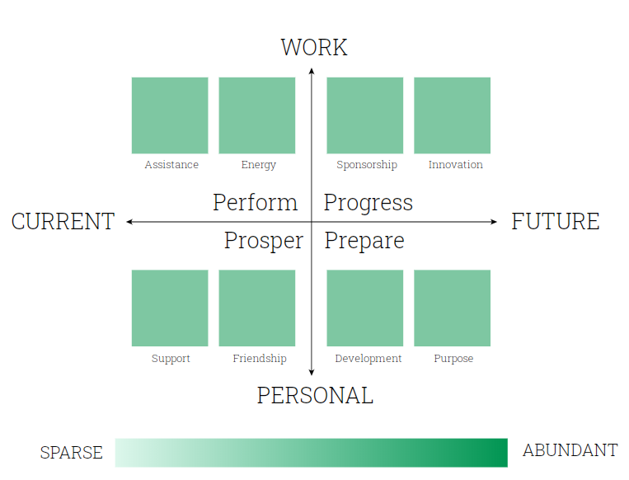

Slide 24
When you look at your resource chart, check to see if your network is providing you with at least some of each of these key resources.
What resources are abundant in your network? (dark green)
What resources are sparse in your network? (light green)
What resources/ relationships are missing in your network, if any?
What relationships would you need to activate?
Personal case study

Slide 25
Networking

Slide 26
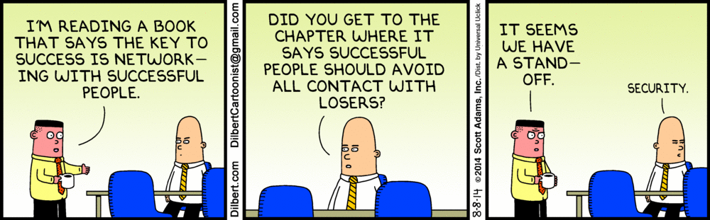
Networking strategies

Slide 27
Why do people feel dirty about networking
Asymmetry
Reciprocity
Underlying Motive
Notes:
1. Asymmetry: Unlike personal ties, professional ties start off asymmetric (there is not the assumption that the relationship will be mutually beneficial)
2. Direct Reciprocity: professional ties are exchange relationships where there is often an expectation of direct reciprocity (I’ll help you if you help me) – personal ties assume reciprocity overtime
3. Underlying Motive: professional ties tend to be motivated by personal gain and accomplishment, whereas personal ties the assumed underlying motive is of belonging.

Slide 28
Re-thinking Networking
“The purposeful building and nurturing of relationships to create a system of information and support for professional and career success.”
Casciaro, T., Gino, F., & Kouchaki, M. (2014).
Notes:
1. Asymmetry: Unlike personal ties, professional ties start off asymmetric (there is not the assumption that the relationship will be mutually beneficial)
2. Direct Reciprocity: professional ties are exchange relationships where there is often an expectation of direct reciprocity (I’ll help you if you help me) – personal ties assume reciprocity overtime
3. Underlying Motive: professional ties tend to be motivated by personal gain and accomplishment, whereas personal ties the assumed underlying motive is of belonging.

Slide 29
Networks for Success
Networks are how work gets done and an important source of influence
Think mindfully about building and expanding your network
Networks aren’t just about taking, just as important is giving

Slide 30
Resources
Cross & Parker. Hidden Power of Social Networks
Cascario et al. Learn to Love Networking. https://hbr.org/2016/05/learn-to-love-networking
Adam Grant. https://www.ted.com/talks/adam_grant_are_you_a_giver_or_a_taker?language=en
Nicholas Christakis
https://www.ted.com/talks/nicholas_christakis_the_hidden_influence_of_social_networks?language=en

Slide 31

TOP TIPS
Be clear about your intentions
Map and plan your ideal network
Don’t wait
Book time in your diary
Get 3rd party introductions
What have you got in common?
Think social, personable!
Make your ask clear
What can you offer?
Follow up
Notes:
Be clear about your intentions – even if that’s building a network to work out what career you want!
Map and plan your ideal network – use the LND to think about diversity, balance, open, closed…
Don’t wait –get started now
Book time in your diary for making and maintaining connections
Get virtual and real life introductions from 3rd party
Think about what you might have in common
Think social, personable connection not just career!
Make your ask clear
Think about what you can offer
Follow up if you’d like to stay in touch

